Slide 1
COS 212 Graphs: Connectivity

Slide 2
Connectivity in Graphs
Can you remove one vertex to make the graph disconnected?
Is the graph below connected?
Graph is connected when a path exists between any 2 vertices
Therefore the above graph is connected
But how connected is the graph?
That is, how difficult or easy is it to make the graph disconnected?
Z
Z
A
R
P
A
R
P
J
N
L
J
N
L

Slide 3
Connectivity in Graphs
An n-connected graph
There are at least n non-overlapping paths between any two vertices
Paths overlap if they have any vertices in common
A 2-connected, or biconnected graph
At least two non-overlapping paths exist between any two vertices
Is the graph on the left biconnected?
What about the graph on the right?
Z
Z
A
R
P
A
R
P
J
N
L
J
N
L

Slide 4
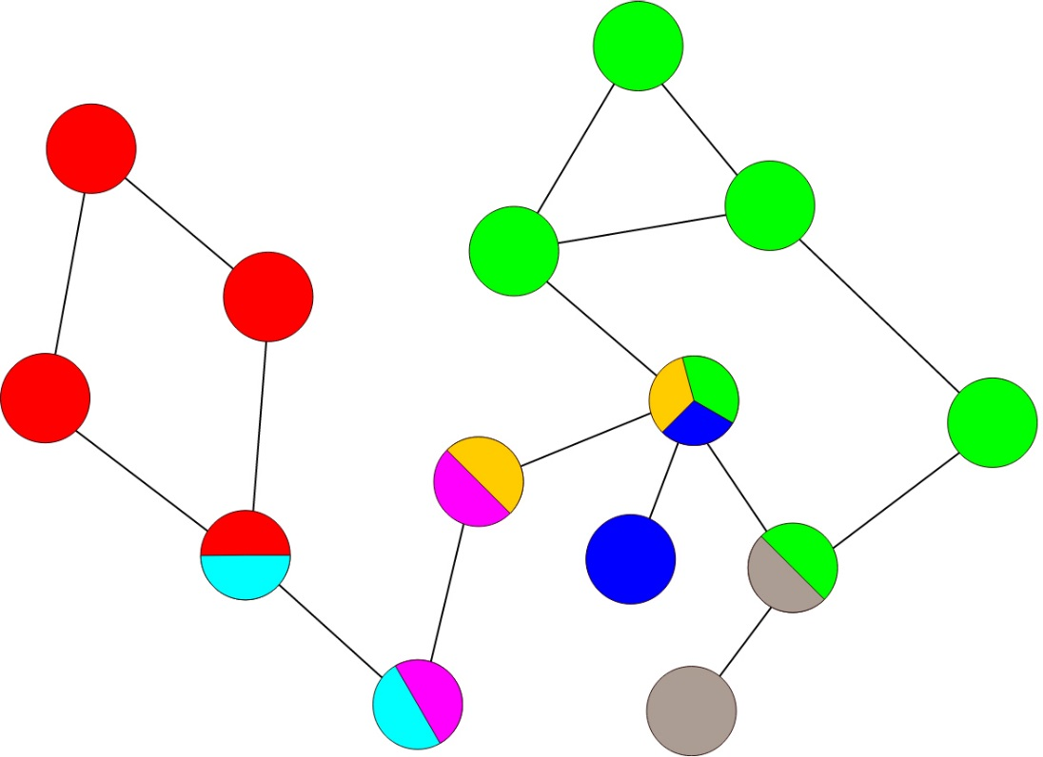
Connectivity in Graphs
Graphs that are not biconnected
There is a vertex that always has to be included on the path between some vertex u and another vertex v
Such vertex is called an articulation point
An articulation point is a “breaking point”
If it is removed, the graph will fall apart into disconnected subgraphs
Biconnected subgraphs are referred to as blocks
How many blocks in the graph below?
Z
A
R
P
J
N
L

Slide 5
Connectivity in Graphs
In many practical situations
If an articulation point fails, we have a problem!
Consider a telecommunications network
We need an algorithm that will identify articulation points in a graph

Slide 6
Connectivity in Graphs
We can reuse depth first search
DFS visits every vertex once, constructing a spanning tree
The root of the spanning tree is A, leaves are L and Z
Edges (PR) and (ZA) are called back edges
Edges that connect back to previously visited vertices
How can we tell that P and R are articulation points?
P’s successors have no back edges connecting to predecessors of P
R’s successors have no back edges connecting to predecessors of R
We’ll modify DFS to keep track of back edges
Z
A
R
P
J
N
L

Slide 7
DFS: Find Articulation Points
Each vertex stores two numeric values: (predecessor, number)
Each vertex initially has a predecessor equal to its number
As DFS goes through the vertices, push all edges onto a stack
If we find a back edge from vertex v to vertex u
Indicate this by updating v’s predecessor to u’s number
Propagate this predecessor back through v’s block
When a recursive call returns control from u back to v
If pred(u) ≥ num(v), no back edges have been found connecting to a predecessor vertex of v, and v is an articulation point
Pop the entire block off the stack, and report them
Z
A
R
P
J
N
L

Slide 8
DFS: Find Articulation Points
blockSearch()
for all vertices v
num(v) = 0 // initialize all vertices as unvisited
i = 1
while there is a vertex v such that num(v) == 0
blockDFS(v)
Z
0
0
A
0
R
P
0
0
J
0
N
L
0
1
i :

Slide 9
DFS: Find Articulation Points
blockDFS(v)
pred(v) = num(v) = i++
for all vertices u adjacent to v
if edge(vu) has not been processed
push(edge(vu))
if num(u) is 0
blockDFS(u)
if pred(u) ≥ num(v)
e = pop()
while e ≠ edge(vu)
output e
e = pop()
output e
else pred(v) = min(pred(v),pred(u))
else if u is not the parent of v
pred(v) = min(pred(v),num(u))
PL
NP
RN
JR
AJ
pred
num
Z
0
1,1
0
0
A
3,3
R
5,5
0
P
J
N
L
0
2,2
6,6
0
4,4
0
1
2
3
4
i :
5
6
7

Slide 10
DFS: Find Articulation Points
blockDFS(v)
pred(v) = num(v) = i++
for all vertices u adjacent to v
if edge(vu) has not been processed
push(edge(vu))
if num(u) is 0
blockDFS(u)
if pred(u) ≥ num(v)
e = pop()
while e ≠ edge(vu)
output e
e = pop()
output e
else pred(v) = min(pred(v),pred(u))
else if u is not the parent of v
pred(v) = min(pred(v),num(u))
PL
NP
RN
JR
P: (PL)
AJ
(PL)
pred
num
Z
0
1,1
Is pred(L) ≥ num(P)?
A
3,3
R
P
5,5
Yes
P is an articulation point or start
Pop from stack until PL is found
2,2
J
4,4
N
L
6,6
7
i :

Slide 11
DFS: Find Articulation Points
blockDFS(v)
pred(v) = num(v) = i++
for all vertices u adjacent to v
if edge(vu) has not been processed
push(edge(vu))
if num(u) is 0
blockDFS(u)
if pred(u) ≥ num(v)
e = pop()
while e ≠ edge(vu)
output e
e = pop()
output e
else pred(v) = min(pred(v),pred(u))
else if u is not the parent of v
pred(v) = min(pred(v),num(u))
PR
NP
RN
R: (PR)(NP)(RN)
(PR)
(NP)
(RN)
JR
P: (PL)
AJ
(PL)
pred
num
Z
0
1,1
Is pred(N) ≥ num(R)?
Yes
Update pred(P) to
min(pred(P),num(R))
min(5,3)
Is pred(P) ≥ num(N)?
5,5
No
A
3,3
R
P
3,5
R is an articulation point or start
N is not an articulation point or start
Pop from stack until RN is found
Set pred(N) = min(pred(N),pred(P))
2,2
J
4,4
N
L
6,6
3,4
7
i :

Slide 12
DFS: Find Articulation Points
blockDFS(v)
pred(v) = num(v) = i++
for all vertices u adjacent to v
if edge(vu) has not been processed
push(edge(vu))
if num(u) is 0
blockDFS(u)
if pred(u) ≥ num(v)
e = pop()
while e ≠ edge(vu)
output e
e = pop()
output e
else pred(v) = min(pred(v),pred(u))
else if u is not the parent of v
pred(v) = min(pred(v),num(u))
ZA
A: (ZA)(RZ)(JR)(AJ)
(ZA)
(RZ)
(JR)
(AJ)
RZ
R: (PR)(NP)(RN)
(PR)
(NP)
(RN)
JR
P: (PL)
AJ
(PL)
pred
num
0
7,7
Z
1,7
1,1
Is pred(Z) ≥ num(R)?
Is pred(J) ≥ num(A)?
Is pred(R) ≥ num(J)?
No
Yes
No
A
3,3
R
3,5
Update pred(Z) to
min(pred(Z),num(A))
min(7,1)
1,3
P
R is not an articulation point or start
A is an articulation point or start
J is not an articulation point or start
Set pred(R) = min(pred(R),pred(Z))
Pop from stack until AJ is found
Set pred(J) = min(pred(J),pred(R))
2,2
J
N
L
6,6
1,2
3,4
7
8
i :

Slide 13
Connectivity in Directed Graphs
Will the same algorithm work on a digraph?
Depends on the definition of “connected”
Weakly connected
A digraph where the corresponding undirected graph structure is connected
Strongly connected
A digraph in which every vertex is reachable from every other vertex
We’ll modify DFS to find strongly connected components
M
A
R
P
J
N
L

Slide 14
DFS: Find Strongly Connected Components
stronglyConnectedComponentSearch()
for all vertices v
num(v) = 0 // initialize all vertices as unvisited
i = 1
while there is a vertex v such that num(v) == 0
strongDFS(v)
M
0
0
A
0
R
P
0
0
J
0
N
L
0
1
i :

Slide 15
DFS: Find Strongly Connected Components
strongDFS(v)
pred(v) = num(v) = i++
push(v) // push vertices, not edges
for all vertices u adjacent to v
if num(u) is 0
strongDFS(u)
pred(v) = min(pred(v),pred(u))
else if num(u) < num(v) and u is on stack
pred(v) = min(pred(v),num(u))
if pred(v) == num(v)
w = pop()
while w ≠ v
output w
w = pop()
output w
M
R
J
A
M
pred
num
4,4
M
0
1,1
0
Is pred(M) == num(M)?
A
3,3
R
0
Yes
0
P
M is the root of an SCC
Pop from stack until M is found
2,2
J
N
L
0
0
0
1
2
3
4
i :
5

Slide 16
DFS: Find Strongly Connected Components
strongDFS(v)
pred(v) = num(v) = i++
push(v) // push vertices, not edges
for all vertices u adjacent to v
if num(u) is 0
strongDFS(u)
pred(v) = min(pred(v),pred(u))
else if num(u) < num(v) and u is on stack
pred(v) = min(pred(v),num(u))
if pred(v) == num(v)
w = pop()
while w ≠ v
output w
w = pop()
output w
L
P
R
L
J
A
M
pred
num
M
4,4
1,1
Is pred(L) == num(L)?
0
Yes
A
3,3
R
P
5,5
L is the root of an SCC
Pop from stack until L is found
J
N
L
0
2,2
0
6,6
5
6
i :
7

Slide 17
DFS: Find Strongly Connected Components
strongDFS(v)
pred(v) = num(v) = i++
push(v) // push vertices, not edges
for all vertices u adjacent to v
if num(u) is 0
strongDFS(u)
pred(v) = min(pred(v),pred(u))
else if num(u) < num(v) and u is on stack
pred(v) = min(pred(v),num(u))
if pred(v) == num(v)
w = pop()
while w ≠ v
output w
w = pop()
output w
N
P
N
P
R
R
L
J
A
M
pred
num
M
4,4
1,1
Is num(R) < num(N), R on stack?
Yes
Is pred(R) == num(R)?
Yes
3,5
Set pred(P) = min(pred(P), pred(N))
A
3,3
R
P
5,5
Set pred(N) to min(pred(N),num(R))
R is the root of an SCC
Pop from stack until R is found
2,2
J
7,7
N
L
6,6
3,7
0
7
i :
8

Slide 18
DFS: Find Strongly Connected Components
strongDFS(v)
pred(v) = num(v) = i++
push(v) // push vertices, not edges
for all vertices u adjacent to v
if num(u) is 0
strongDFS(u)
pred(v) = min(pred(v),pred(u))
else if num(u) < num(v) and u is on stack
pred(v) = min(pred(v),num(u))
if pred(v) == num(v)
w = pop()
while w ≠ v
output w
w = pop()
output w
J
N
P
R
L
J
A
M
pred
num
M
4,4
1,1
Is pred(J) == num(J)?
A
3,3
R
P
3,5
Yes
J is the root of an SCC
Pop from stack until J is found
2,2
J
3,7
N
L
6,6
i :
8

Slide 19
DFS: Find Strongly Connected Components
strongDFS(v)
pred(v) = num(v) = i++
push(v) // push vertices, not edges
for all vertices u adjacent to v
if num(u) is 0
strongDFS(u)
pred(v) = min(pred(v),pred(u))
else if num(u) < num(v) and u is on stack
pred(v) = min(pred(v),num(u))
if pred(v) == num(v)
w = pop()
while w ≠ v
output w
w = pop()
output w
A
J
N
P
R
L
A
M
pred
num
M
4,4
1,1
Try repeating the procedure on the same graph with the arrow between A and M reversed
Is pred(A) == num(A)?
Yes
Is num(M) < num(A), M on stack?
A
3,3
R
P
3,5
No
A is the root of an SCC
No action required
Pop from stack until A is found
2,2
J
3,7
N
L
6,6
i :
8

